Slide 1
To Go or Not To Go: A Statistical Analysis of Ratings of Virtual and In-Person Events
Cara Krupnikoff-Salkin, Lauren Meyer, Nicole Reardon
SDS 290, December 2021

Slide 2
Introduction
Hypotheses:
There will be lower scores for virtual events than in-person events
There will be an interaction effect between format and type of event; social events will have lower scores when virtual.
Research question:
What are the effects of type of meeting and format of meeting on feelings about attendance?

Slide 3
Methods: Factors
Event Type
Academic
Business
Social
Event Format
In-Person
Zoom
Factors are crossed, with no blocking.

Slide 4
Methods: Measures
5-point Likert scale with various statements relating to their feeling about attending the event
Worthwhile - Connect w/others
Waste of time - Value
Engagement - Attend
One item focusing on choice to test the validity of the scenarios

Slide 5
Methods: Units
Type | Format | n
Academic | In-Person | 11
Academic | Virtual | 11
Business | In-Person | 12
Business | Virtual | 13
Social | In-Person | 11
Social | Virtual | 11

Slide 6
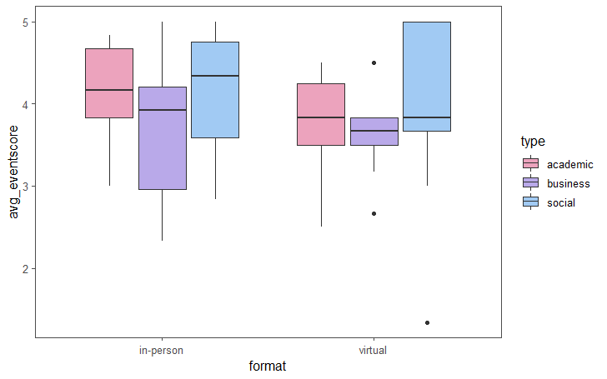
Results

Slide 7
Results
 | DF | Sum Sq | Mean Sq | F Value | P Value
Type | 2 | 1.46 | 0.73 | 1.26 | 0.29
Format | 1 | 1.01 | 1.01 | 1.74 | 0.19
Type:Format | 2 | 0.13 | 0.06 | 0.11 | 0.90
Residuals | 65 | 37.70 | 0.58

Slide 8
Results: Analyzing the Validity of Our Design
Looking at choice: participants rated their freedom of choice to attend the business scenario as lower, but removing business from the model still yields insignificant differences overall
Looking at the response scale: when isolating the ratings for the different Likert items, there are different levels of significance within the model

Slide 9
Conclusion
Findings
Limitations
Since our results were not statistically significant, we do not have evidence to support our hypotheses.
Only 69 completed responses
Convenience sample, nonrepresentative
Possible inconsistent scale scores
Unbalanced conditions (less perceived choice for business scenario)

Slide 10
Conclusion: Future Research
Looking at factors relating to format and interest in events is important going forward
How can we expand virtual programming beyond the pandemic to create engaging and meaningful events in accessible formats?
Extending our research to look at factors such as:
Mandatory vs optional events
Inherent differences between virtual and in-person events
Hybrid events
Interest and fatigue

